Slide 1
§6-2 Tests for Parallelograms
Test to see if a quadrilateral IS a parallelogram.
Best way to test?
  Let’s check the converses of the theorems about parallelograms!
  If the hypothesis of the converse provides enough information to conclude opposite sides are parallel (the def. of a parallelogram) then the converse is valid.

Slide 2
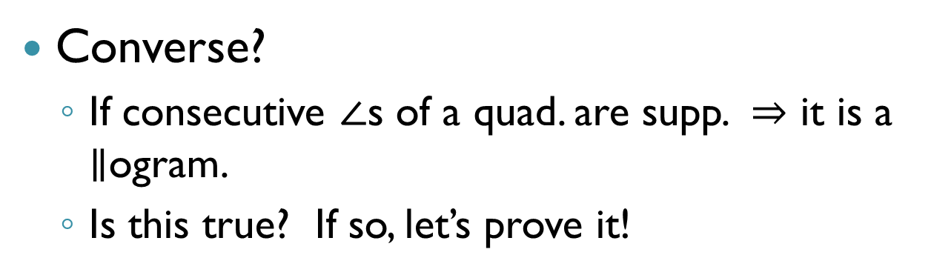


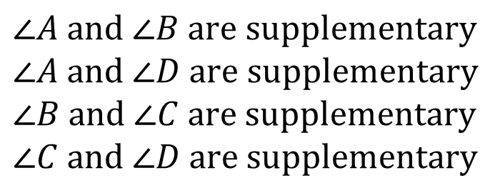
1) If a quad. is a $∥$ogram $⇒$ consecutive $∠$s are supp.
Converse?
  If consecutive $∠$s of a quad. are supp. $⇒$ it is a $∥$ogram.
  Is this true? If so, let’s prove it!
A
B
Given:
$$∠A and ∠B are supplementary$$
$$∠A and ∠D are supplementary$$
$$∠B and ∠C are supplementary$$
$$∠C and ∠D are supplementary$$
D
C
Prove:
$ABCD$is a $∥$ogram

Slide 3







Proof
$∠A \&∠B$ are CIAs
Assume
$$∠A is supp to ∠B$$
$$\overline{AD}∥\overline{BC}$$
Given
CIA Converse
$$ABCD is a∥ogram$$
$∠A \&∠B$ are CIAs
Assume
$$∠B is supp to ∠C$$
$$\overline{AD}∥\overline{BC}$$
Given
CIA Converse

Slide 4
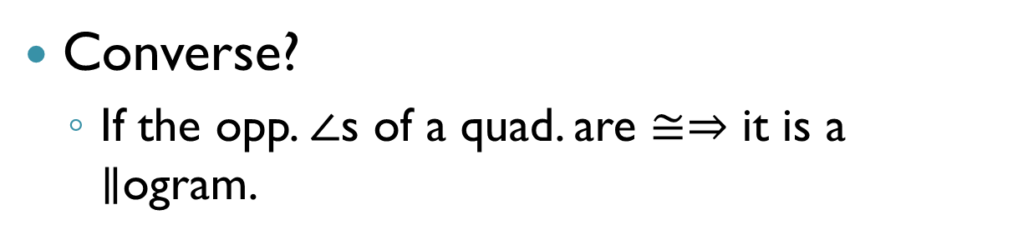
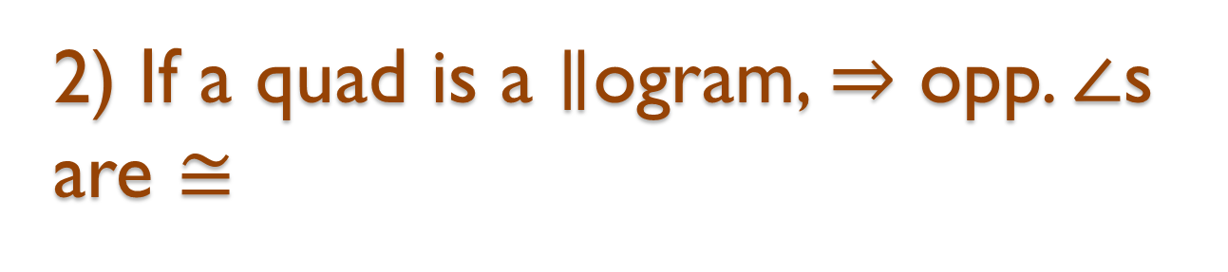

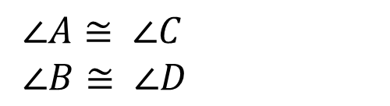
2) If a quad is a $∥$ogram, $⇒$ opp. $∠$s are $≅$
Converse?
  If the opp. $∠$s of a quad. are $≅⇒$ it is a $∥$ogram.
A
B
Given:
$∠A≅ ∠C$
$∠B≅ ∠D$
Prove:
$ABCD$is a $∥$ogram
D
C
You will prove this theorem for homework!

Slide 5
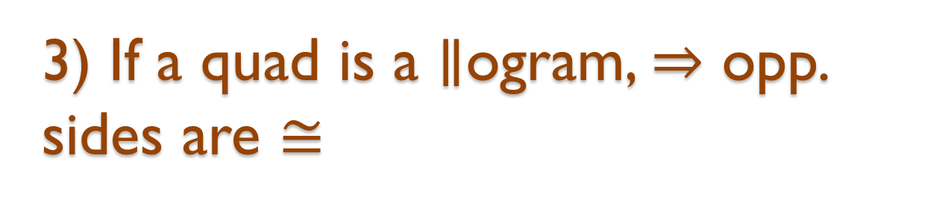

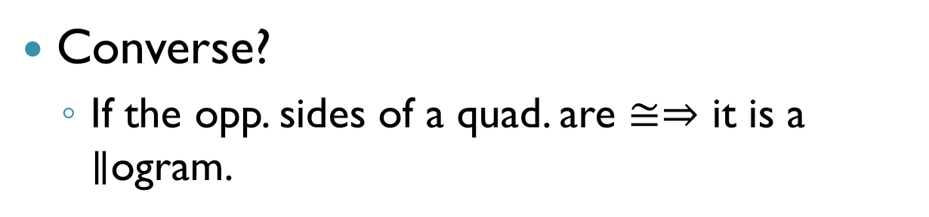
3) If a quad is a $∥$ogram, $⇒$ opp. sides are $≅$
Converse?
  If the opp. sides of a quad. are $≅⇒$ it is a $∥$ogram.
A
B
Given:
$\overline{AB}≅ \overline{CD}$
$\overline{BC}≅\overline{AD}$
Prove:
$ABCD$is a $∥$ogram
D
C
Notes:
Ended here for 9A

Slide 6






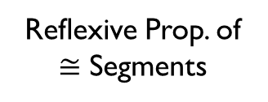






Proof
$∠1\&∠2$ are AI $∠$s
$$∠1≅∠2$$
Assume
CPCTC
$$\overline{AB}≅\overline{CD}$$
$$\overline{AD}∥\overline{BC}$$
Given
AI $∠$ Converse
$$\overline{BC}≅\overline{AD}$$
$$ΔADC≅ΔCBA$$
Given
SSS Post.
$$ABCD is a∥ogram$$
$$\overline{AC}≅\overline{CA}$$
Reflexive Prop. of $≅$ Segments
$$∠3≅∠4$$
CPCTC
$$\overline{AD}∥\overline{BC}$$
A
AI $∠$ Converse
B
$∠3\&∠4$ are AI $∠$s
1
3
Assume
4
2
D
C

Slide 7
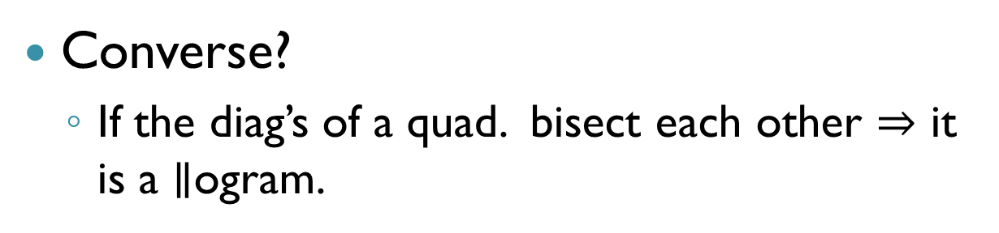
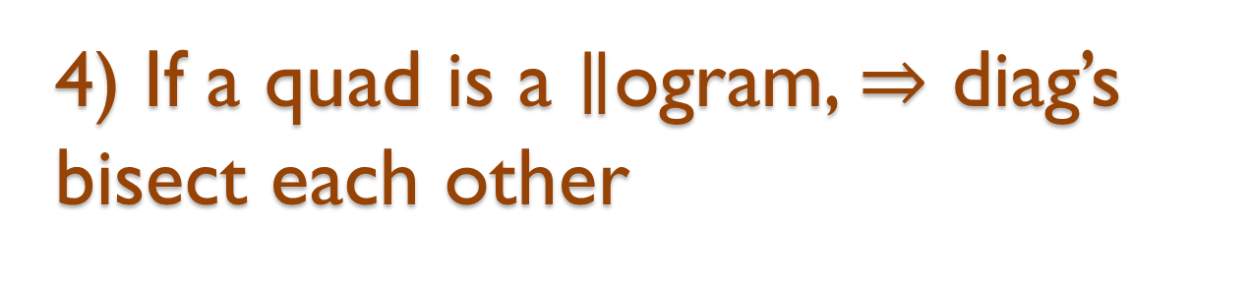
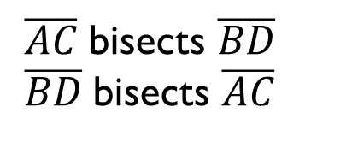
4) If a quad is a $∥$ogram, $⇒$ diag’s bisect each other
Converse?
  If the diag’s of a quad. bisect each other $⇒$ it is a $∥$ogram.
A
B
Given:
$\overline{AC}$bisects $\overline{BD}$
$\overline{BD}$bisects $\overline{AC}$
E
Prove:
$ABCD$is a $∥$ogram
D
C

Slide 8





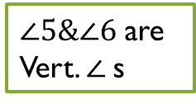







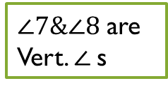
Proof
$∠1\&∠2$ are AI $∠$s
$$∠1≅∠2$$
$∠5\&∠6$ are Vert. $∠$s
Assume
$$∠5≅∠6$$
CPCTC
Assume
Vert. $∠$Th.
$$ΔADE≅ΔCBE$$
$$\overline{AD}∥\overline{BC}$$
SAS Post.
$\overline{AC}$ bisects $\overline{BD}$
$$\overline{BD}≅\overline{ED}$$
AI $∠$ Converse
Def. Segment bisector
Given
$$\overline{BD} \text{bisects} \overline{AC}$$
$$\overline{AE}≅\overline{EC}$$
$$ABCD is a∥ogram$$
Def. Segment bisector
Given
$∠7\&∠8$ are Vert. $∠$s
$$ΔAEB≅ΔCED$$
$$∠7≅∠8$$
$$\overline{AD}∥\overline{BC}$$
Assume
Vert. $∠$Th.
SAS Post.
AI $∠$ Converse
A
B
3
$$∠3≅∠4$$
1
8
CPCTC
6
E
5
7
$∠3\&∠4$ are AI $∠$s
4
2
Assume
D
C

Slide 9
Are there any other tests we could do?
What if we only had information about one pair of sides?
  What would be the minimum needed to prove something about the other pair?
A
B
D
C

Slide 10





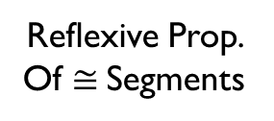

Proof
$∠1\&∠2$ are AI $∠$s
$$∠1≅∠2$$
Assume
$$\overline{AC}≅\overline{CA}$$
CPCTC
Reflexive Prop. Of $≅$Segments
$$\overline{AD}∥\overline{BC}$$
$$\overline{AB}≅\overline{CD}$$
AI $∠$ Converse
Given
$$ΔABC≅ΔCDA$$
SAS Post.
$$ABCD is a∥ogram$$
$$∠3≅∠4$$
AI $∠$ Th.
A
B
1
3
$$\overline{AB}∥\overline{CD}$$
Given
2
4
D
C

Slide 11
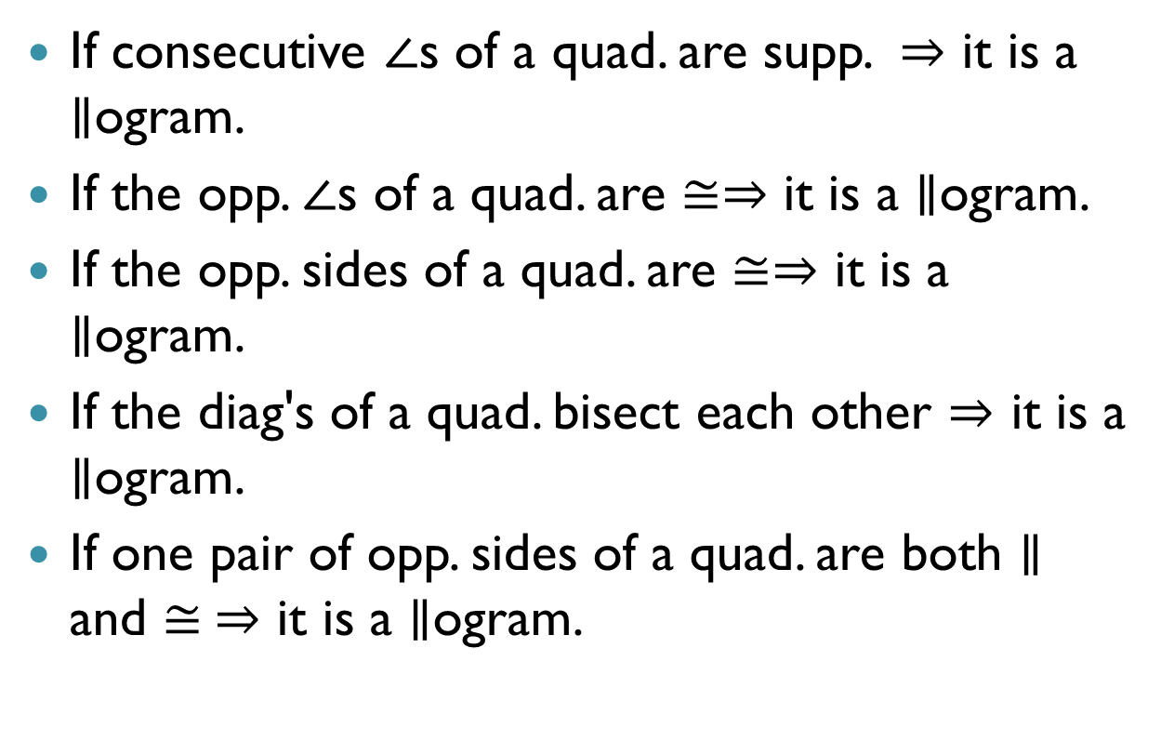

Ways to prove a quad. is a $∥$ogram:
  If consecutive $∠$s of a quad. are supp. $⇒$ it is a $∥$ogram.
  If the opp. $∠$s of a quad. are $≅⇒$ it is a $∥$ogram.
  If the opp. sides of a quad. are $≅⇒$ it is a $∥$ogram.
  If the diag's of a quad. bisect each other $⇒$ it is a $∥$ogram.
  If one pair of opp. sides of a quad. are both $∥$ and $≅ ⇒$ it is a $∥$ogram.

